Slide 1
Automation Testing
Selenium with Java

Slide 2
Software Testing
To test an software application to find the defects/bugs
Manual Software Testing
Done by humans
Time consuming
Efficiency may tend to decrease after long hours of testing
Accuracy of results is less
Automation Software Testing
Done with the help of a tool
Many times faster than manual
Same efficiency is maintained with continuous hours of testing
Accuracy of results is more

Slide 3
Types of Software in general
System softwares
Can be installed & used on a particular Operating system
Example - MS Word, VLC media player, Audio converter, Skype for PC
Web based
Applications, hosted on server & can be accessed through browser
Example - Any Finance, Ecommerce & Healthcare application

Slide 4
Automation Testing Categories
Functional Testing/Behavioural Testing Focuses on functionality of the software to be tested | Non Functional Testing Focuses on performance of the software/application
Test the business requirement of the client | Test the customer expectations
Checks actual vs expected between | Check performance on basis of speed, load, usability & recoverability etc
Ex - Smoke, Sanity, Re-Testing, Regression, Integration, UAT testing etc | Load, Stress, Recoverability, Scablity & Security testing etc
Tools - Selenium, QTP/UFT , RFT, Test Complete | Jmeter, LoadRunner

Slide 5

Why Selenium
Price - Free
Platform - Mac, Windows & Linux
Language Supported - Java, C#, PHP, Ruby, Perl, JavaScript, Python
Used For - Web Based & Mobile Application (Appium)
Supported Browsers - Chrome, Firefox, Safari, Opera, Edge, IE etc

Slide 6
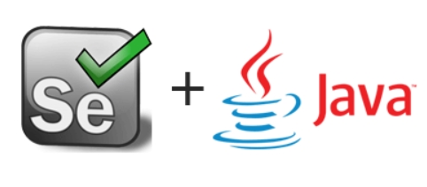
Why Selenium with Java
Price - JDK is free until version 11
Platform Independent - Mac, Windows & Linux
Community Support - More than other languages
Used For - Web Based & Mobile Application (Appium)
Speed of Code Execution - Faster than some languages ex. Python

Slide 7
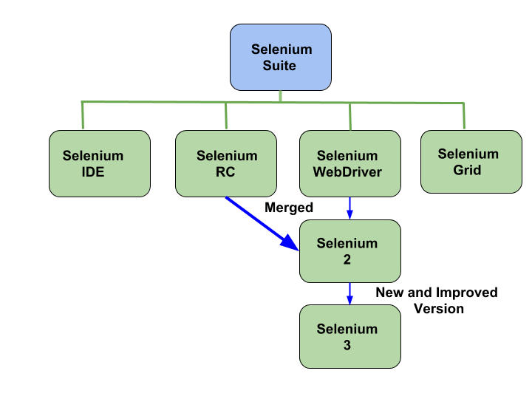
Versions of Selenium

Slide 8
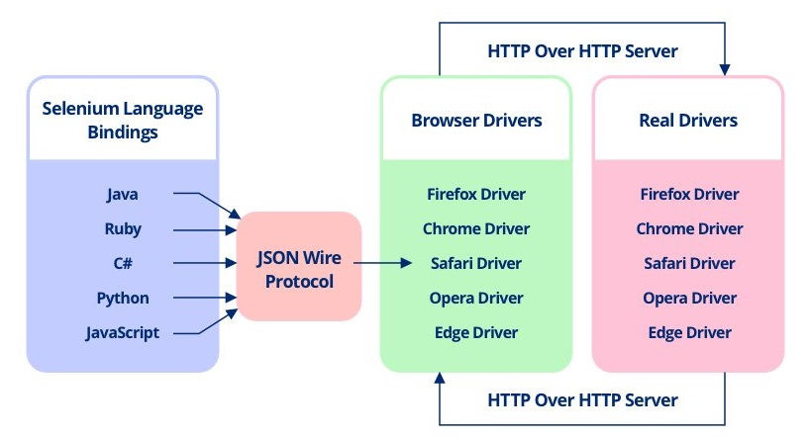
Selenium WebDriver Architecture - I

Slide 9
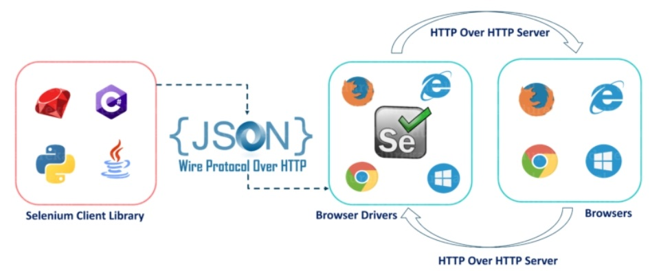
Selenium WebDriver Architecture - II

Slide 10
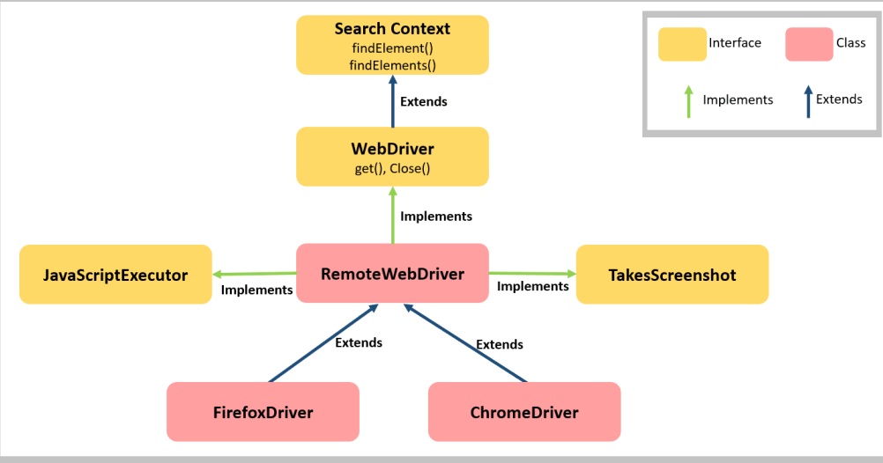
Selenium WebDriver Architecture - III

